Slide 1

Data Driven Decisions
Beren Clinical Data Mart
Circulants
Solutions | Platforms | Services

Slide 2
Clinical Data Mart Project’s Objectives
Accelerating Insights
AWS Infrastructure setup for sFTP and SAS installation Cloud based data integration model with data movement and transformation Visualization of study reports via Spotfire dashboard
Current Phase : Clinical Data – EDC, PK, Safety, Lab Future Phase : Bio-Informatics, Translational, Regulatory, Product Development, Quality, Product Manufacturing, Supply Chain & Commercial
Data access, management & provisioning for agile decision making Innovative methods & root cause analysis to uncover trends, patterns & hidden insights Deep data interrogation through ML, AI & predictive modeling
Business Requirements
Data Domains
Capabilities
Deliver Key Clinical & Research Business Decisions

Slide 3
Scope
© Circulants
3

Slide 4
Project Scope: Phase I
AWS Infrastructure setup
AWS architecture to accommodate clinical sFTP, SAS, Data Lake & Spotfire
sFTP setup
Access Request Form (ARF) for CRO/Vendors/Contractors/Beren Employees
Vendor and Study onboarding, archival & AD integration
Validation via IQ/OQ and PQ
SAS Installation
SAS Folder setup, Initialization & Linker Programs
Validation via IQ/OQ and PQ
Data Mart
Data Model development for EDC data
Metadata DB setup & DQM – DTS mapping & standardization for 1 study (limited to 10 vendors)
Spotfire
Connection to Data Mart for report generation – Clinical Overview dashboard & some safety dashboards (limited to 25 reports)

Slide 5
Validation Approach
Validated Systems
Non-Validated Systems
sFTP
SAS
Data Mart
Spotfire
Beren’s AWS Validated Cloud Infrastructure

Slide 6
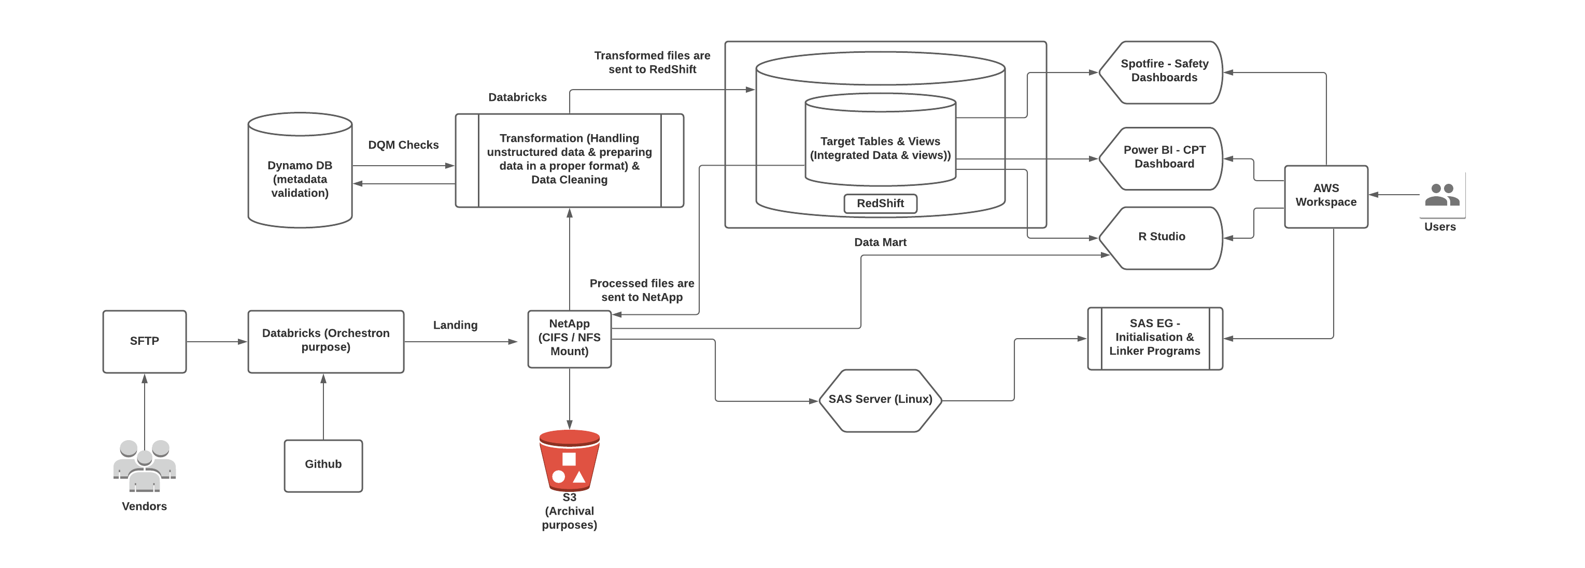
System Architecture Draft
Notes:
NetApp ONTAP Cloud Solutions for AWS – Flexible, Cost effective, non-disruptive workloads with development, testing, security and disaster recovery. Fast-fluid data movement.
Multiple regions can be accessed. Deploy new solutions in < 10 mins. Good data fabric. Optimised for flash and capacity. 4:1 reduction in capacity. Triple data protection. Stringent Data retention policy. Unifies storage infrastructure

Slide 7
Beren Clinical Data Mart (BCDM)
The Project
© Circulants
7

Slide 8
Project Team & Communication Plan
Project Team
Beren |  | Circulants
Project Sponsor | Suman Bhattacharya | PMO | Satyoki Chatterjee
Project Manager | Hannes Holste | Infrastructure Lead | Sisir Kumar
IT Owner | Kevin Hernandez | Cloud Engineer | Arun Detwal
Business Owner | Hannes Holste | Data Mart Lead | Ashok Geeta Kumar
 |  | Data Mart Developer | Sushanth Shetty
 |  | SAS Development Lead | Gopal Joshi
 |  | SAS Developer | Karan Joshi
 |  | Spotfire Developer | Mayank
 |  | Validation Engineer | Kishan
Weekly Project Meeting​
Weekly Project Progress, Task Tracking and Status Report
Monthly Steering Committee Meeting​
Monthly Achievements, Overall Project Progress again Key Milestone, Issue Escalation, Risks and Mitigation​
© Circulants

Slide 9
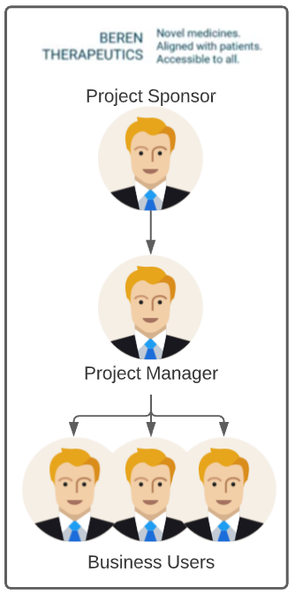
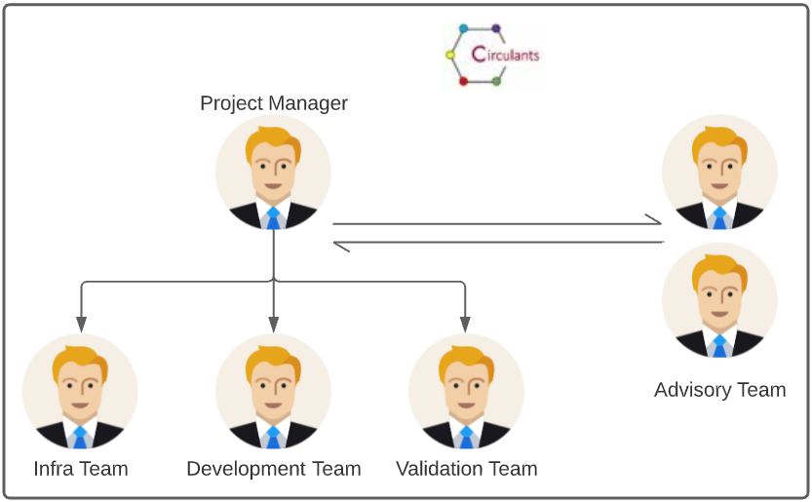
Stakeholders Engagement Model
Circulants Project Manager:
Single point of contact for the project
Responsible for project planning, milestone sign off, resource planning
Review of deliverables
Risk identification/Escalation
Beren Project Manager
Responsible for coordination of resources at Beren
Escalation to Beren data vendors as needed
Communication Mode – Microsoft Team/ Phone/ Emails
Document Repository – SharePoint/ MS Team
Signatories | Names
Business Owner | Hannes Holste
System Owner | Kevin Hernandez
Quality / IT Compliance | TBD
© Circulants

Slide 10
Schedule – Phase I (Proposed)
Project | Activity | Sep |  |  |  | Oct |  |  |  | Nov |  |  |  |  | Dec
Clinical Data Mart - Phase 1 |  | 6-Sep | 13-Sep | 20-Sep | 27-Sep | 4-Oct | 11-Oct | 18-Oct | 25-Oct | 1-Nov | 8-Nov | 15-Nov | 22-Nov | 29-Nov | 6-Dec | 13-Dec | 20-Dec | 27-Dec
 | Procure AWS documentation from Beren
 | Detailed Project Plan/Validation Approach
 | Overall Data Architecture
Work stream - sFTP
 | Overall Data Architecture Design
 | Setup CRO File sharing process
 | Access Request Form Process & setup
 | Vendor Onboarding & AD setup by Study
 | Study Onboarding & Archival
 | Test Plan/Scripts for UAT
 | End User Training Material
Work Stream - SAS
 | SAS Requirement Confirmation
 | Quality Requirements Assessment and Confirmation
 | Validation Plan approval
 | Creation and Approval of IQ/OQ/PQ Documents
 | SAS Installation (SAS Studio / SAS EG)
 | Creation of SAS Folder Setup
 | Creation of Initialization/Linker Programs
 | End to End Testing of SAS installation excluding data migration from legacy systems
 | Creation of SAS Admin SOP
 | SAS User Training Material
 | Validation Summary Report
 | Production Go Live
Work Stream - Data Mart
 | Design and Development of Data Model
 | DB setup for Metadata configuration
 | Data Quality Management (DQM) – DTS mapping and data validation and standardization
 | Error Notifications to users
 | Tables & Views setup for reporting
 | Testing and Go Live
Work Stream - Spotfire
 | Installation of Spotfire Server and client
 | Connection to Clinical Data Mart
 | Development of Reports – limited to 25 reports

Slide 11
Documentations
Sl No | Documents (Pre-Requisites) | Doc # | Assignee
1 | Change Control | TBD | Beren
2 | IT SOP | TBD | Beren
3 | SOP of Computer System Validation | TBD | Beren
4 | Computer System Risk Assessment | TBD | Beren
**Required before project starts
Sl No | Documents (Validation Documents) | Doc # | Assignee | Approval
1 | Validation Plan (VP) | TBD | Circulants | Beren
2 | User Requirements Specifications (URS) | TBD | Circulants | Beren
3 | Configurations Specifications | TBD | Circulants | Beren
4 | Installation Qualification and Execution(IQ) | TBD | Circulants | Beren
5 | Operational and Performance Qualification and Execution(OQ/PQ) | TBD | Circulants | Beren
6 | Requirement Traceability Matrix | TBD | Circulants | Beren
7 | Validation Summary | TBD | Circulants | Beren
8 | Project Sign-Off | TBD | Circulants
Sl No | Documents (User Guides) | Doc # | Assignee
1 | Work Instruction Guide for SAS | TBD | Circulants
2 | SOP of System Administration | TBD | Circulants
3 | User Guide for Spotfire | TBD | Circulants
4 | Technical Design Document | TBD | Circulants
**Delivered after Project Sign-off
© Circulants

Slide 12




Circulants Support Model
End User
Automated Alert
Support Center
Service Desk - Level 1 Support
Triage
Ticket Handling
Troubleshooting Issue
Service Escalations
EDL – Level 2 Support
Incident / Problem Management
Patch Management
Third Party L3 Support
Change Request
Capacity Management

Slide 13
Data Strategy
© Circulants
13

Slide 14
Data Strategy
What Constitutes Data Strategy
1 of 4
Audit & Operations Control
Data Reconciliation
Metadata & Lineage
Data Quality
Infrastructure & Platform Setup
ETL & Building data Domains
Data Strategy
Data Security & Access Controls
Data Curation & Transformation
Data Governance
Machine Learning & Ops
Ingestion
Devops
© Circulants

Slide 15
Questions
© Circulants
15

Slide 16
Information Capturing for Studies
S. No. | Program Name | Studies | CRO / Vendor (Source) | Type of Data | File Names | File Type | File Size | Password Protected (Y/N) | File Receipt Frequency | Transmission (SFTP/EMAIL/Thumb Drive) | File Fetch Mechanism (Pull/Push) | FTP PATH (URL) | UserID/Password for the FTP Account | Datasets are snapshots (do we need to do full reload after stipulated time?) | Comments

Slide 17
Questions: General
1 | Validation | We propose to use existing AWS validation documents for installation of SAS server/client and sFTP server.
2 | Protected | Are there any files that are password protected? Any AD securities in place already?
3 | Vendor Files | What is the current process of receiving the files provided by vendors? Via which medium? Types – Blinded, Un-Blinded
4 | Access | How Circulants will get access to data and system?
5 | Onboarding | Do we use the ARF that is in use at Beren? Or do we create a new one?
6 | VPC | We propose to use the same VPC that is in place.
7 | Server & Storage | We propose to follow the relevant steps as mentioned in the IOQ.
8 | DTA | What are the DTAs in place?
© Circulants
17

Slide 18
Proposed Persona Matrix
SL No | Persona Name | Persona Details | Access
 |  |  | Read / Write | Read Only
1 | IT Admin
2 | Analyst
3 | Data Management
4 | External Research
© Circulants
18

Slide 19
Sample SAS Directory Structure
Beren 001
Single Study
Pooled Study
Utilities
CSR
Docs
DSUR - 2021
Utilities
Biostats
Data
Docs
Output
Data
TLFs
PGMS
Testing
Adam
Raw
SDTM
Dataspecs
Timelines
TLF Shell
TLFs
PGMS
Testing
PGMS
Testing
PGMS
Testing
PGMS
Testing
Define
Biostats
Data
Docs
Utilities
Outputs
Biostats
TLFs
PGMS
Testing
Adam
Raw
SDTM
Dataspecs
Timelines
TLF Shell
History
Lookups
Macros
Templates
TLFs
PGMS
Testing
Beren A01
Beren A02
Beren A03
History
PGMS
Testing
Beren A01
Beren A02
Beren A03
History
PGMS
Testing
Beren A01
Beren A02
Beren A03
History
PGMS
Testing

